Slide 1
Module 5-Transport Layer

Slide 2
Transport Layer
It is the heart of the whole protocol hierarchy.
Its task is to provide reliable, cost-effective data transport from the source machine to the destination machine, independently of the physical network or networks currently in use.

Slide 3
The Transport Service
Defines what kind of service is provided to the application layer
Provides Two types of transport services:
connection-oriented transport service using TCP
connectionless transport service uing UDP
Egs: client-server computing and streaming multimedia
Both are similar to Network layer services
But difference is
transport code runs entirely on the users' machines,
but the network layer mostly runs on the routers, which are operated by the carrier

Slide 4
Services Provided to the Upper Layers
The ultimate goal of the transport layer is to provide efficient, reliable, and cost-effective service to its users, normally processes in the application layer.
To achieve this goal, the transport layer makes use of the services provided by the network layer.
The hardware and/or software within the transport layer that does the work is called the transport entity.
The transport entity can be located in the operating system kernel, in a separate user process, in a library package bound into network applications, or conceivably on the network interface card

Slide 5
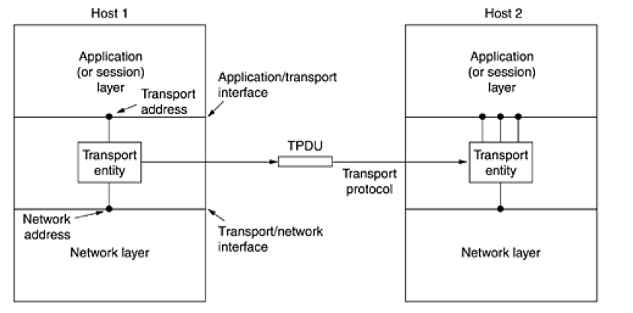
The (logical) relationship of the network, transport, and application layers

Slide 6
TPDU (Transport Protocol Data Unit)
TPDU (Transport Protocol Data Unit) for messages sent from transport entity to transport entity.
Thus, TPDUs (exchanged by the transport layer) are contained in packets (exchanged by the network layer).
In turn, packets are contained in frames (exchanged by the data link layer).
When a frame arrives, the data link layer processes the frame header and passes the contents of the frame payload field up to the network entity.
The network entity processes the packet header and passes the contents of the packet payload up to the transport entity.

Slide 7
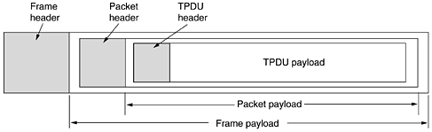
Nesting of TPDUs, packets, and frames

Slide 8
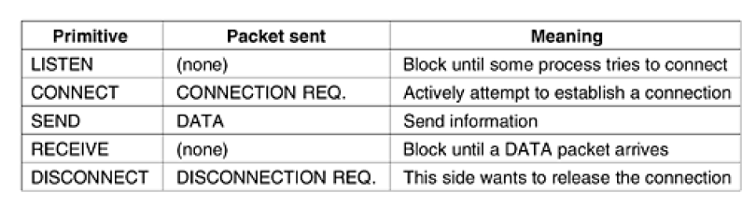
Transport Service Primitives
Transport Service Primitives allow transport users (application programs) to access the transport service.
The following are the primitives for a simple transport service

Slide 9
Service primitive example
Eg: Consider an application with a server and a number of remote clients.
1. The server executes a “LISTEN” primitive by calling a library procedure that makes a System call to block the server until a client turns up.
2. When a client wants to talk to the server, it executes a “CONNECT” primitive, with “CONNECTION REQUEST” TPDU sent to the server.
3. When it arrives, the TE unblocks the server and sends a “CONNECTION ACCEPTED” TPDU back to the client.
4. When it arrives, the client is unblocked and the connection is established. Data can now be exchanged using “SEND” and “RECEIVE” primitives.

Slide 10
Service primitive example
5. When a connection is no longer needed, it must be released to free up table space within the 2 transport entries, which is done with “DISCONNECT” primitive by sending “DISCONNECTION REQUEST” TPDU.
This disconnection can b done either by asymmetric variant (connection is released, depending on other one) or by symmetric variant (connection is released, independent of other one).

Slide 11
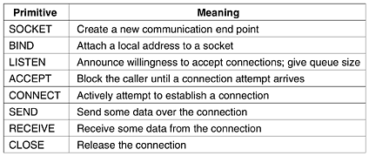
Primitives are widely used for Internet programming

Slide 12
Addressing
Whenever we need to deliver something to one specific destination among many, we need an address.
At the data link layer, we need a MAC address to choose one node among several
nodes if the connection is not point-to-point.
At the network layer, we need an IP address to choose one host among millions.
At the transport layer, we need a transport layer address, called a port number, to choose among multiple processes running on the destination host
In the TCP/IP protocol suite, the port numbers are integers between 0 and 65,535 (16 bits).
TCP/IP has decided to use universal port numbers for servers; these are called well-known port numbers.
Every client process knows the well-known port number of the corresponding server process

Slide 13
Types of ports
Internet Corporation for Assigned Names and Numbers (ICANN) divided the port numbers into three ranges
Well-known ports - The ports ranging from 0 to 1,023
Registered ports - The ports ranging from 1,024 to 49,151
Dynamic ports - The ports ranging from 49,152 to 65,535

Slide 14
Types of ports
Internet Corporation for Assigned Names and Numbers (ICANN) divided the port numbers into three ranges
Well-known ports –
The ports ranging from 0 to 1,023 are assigned and controlled by ICANN.
These are the well-known ports.
Registered ports –
The ports ranging from 1,024 to 49,151 are not assigned or controlled by ICANN.
They can only be registered with ICANN to prevent duplication.
Dynamic ports –
The ports ranging from 49,152 to 65,535 are neither controlled nor registered.
They can be used as temporary or private port numbers.

Slide 15
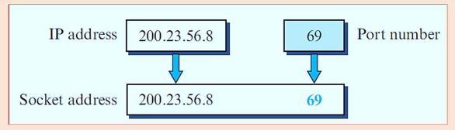
Socket Addresses
A transport-layer protocol in the TCP suite needs both the IP address and the port number, at each end, to make a connection.
The combination of an IP address and a port number is called a socket address.
The client socket address defines the client process uniquely and server socket address defines the server process uniquely.

Slide 16
Transport layer protocols
The Internet has two main protocols in the transport layer, a connectionless protocol and a connection-oriented one.
The connectionless protocol is UDP.
The connection-oriented protocol is TCP.

Slide 17
UDP (User Datagram Protocol )
The User Datagram Protocol (UDP) is a connectionless, unreliable transport protocol.
UDP is a very simple protocol using a minimum of overhead.
If a process wants to send a small message and does not care much about reliability, it can use UDP.
Sending a small message using UDP takes much less interaction between the sender and receiver than using TCP.
UDP packets, called user datagrams
UDP Doesn’t ensure orderly arrival of data
It has limited error checking

Slide 18
UDP advantages(Applications)
Protocol with less overhead
Sending a message using UDP requires less interaction between sender and receiver
Convenient protocol for multimedia and multicasting applications
Used in some route updating protocols like RIP(routing information protocol)
Used in DNS(domain name system)

Slide 19
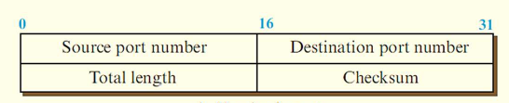
UDP header
UDP transmits segments consisting of an 8-byte header followed by the payload

Slide 20
UDP header
Source port, destination port:
Identifies the end points within the source and destination machines.
UDP length:
Includes 8-byte header and the data
UDP checksum:
It is an optional field used for error detection

Slide 21
Applications of UDP
RPC(Remote procedural call)
RTTP(Real time transport protocol)

Slide 22
Remote procedure call
When a process on machine 1 calls a procedure on machine 2, the calling process on 1 is suspended and execution of the called procedure takes place on 2.
Information can be transported from the caller to the callee in the parameters and can come back in the procedure result.
No message passing is visible to the application programmer.
This technique is known as RPC (Remote Procedure Call)
Traditionally, the calling procedure is known as the client and the called procedure is known as the server.

Slide 23
Remote procedure call
In the simplest form, to call a remote procedure, the client program must be bound with a small library procedure, called the client stub, that represents the server procedure in the client’s address space.(stub knows which machine to contact for that procedure)
Similarly, the server is bound with a procedure called the server stub.
These procedures hide the fact that the procedure call from the client to the server is not local

Slide 24
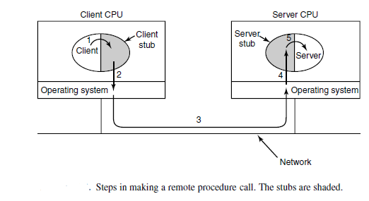
Remote procedure call

Slide 25
Remote procedure call
Step 1 is the client calling the client stub. This call is a local procedure call, with the parameters pushed onto the stack in the normal way.
Step 2 is the client stub packing the parameters into a message and making a system call to send the message. Packing the parameters is called marshaling.
Step 3 is the operating system sending the message from the client machine to the server machine.
Step 4 is the operating system passing the incoming packet to the server stub.
step 5 is the server stub calling the server procedure with the unmarshaled parameters.
The reply traces the same path in the other direction.

Slide 26
TRANSMISSION CONTROL PROTOCOL (TCP)
TCP stands for Transmission Control Protocol.
It is a transport layer protocol that facilitates the transmission of packets from source to destination.
It is a connection-oriented protocol that means it establishes the connection prior to the communication that occurs between the computing devices in a network.
This protocol is used with an IP protocol, so together, they are referred to as a TCP/IP.

Slide 27
Features of TCP protocol
Transport Layer Protocol
Reliable
Order of the data is maintained
Connection-oriented
Full duplex
Stream-oriented

Slide 28
Features of TCP protocol
Transport Layer Protocol
TCP is a transport layer protocol as it is used in transmitting the data from the sender to the receiver.
Reliable
TCP is a reliable protocol as it follows the flow and error control mechanism.
It also supports the acknowledgment mechanism, which checks the state and sound arrival of the data.
Order of the data is maintained
This protocol ensures that the data reaches the intended receiver in the same order in which it is sent.
Connection-oriented
It is a connection-oriented service that means the data exchange occurs only after the connection establishment.
When the data transfer is completed, then the connection will get terminated.

Slide 29
Features of TCP protocol
Full duplex
It is a full-duplex means that the data can transfer in both directions at the same time.
Stream-oriented
TCP is a stream-oriented protocol as it allows the sender to send the data in the form of a stream of bytes and also allows the receiver to accept the data in the form of a stream of bytes.

Slide 30
The TCP Segment Header
Every segment begins with a fixed-format, 20-byte header.
The fixed header may be followed by header options
Segments without any data are legal and are commonly used for Acknowledgements and control messages.

Slide 31
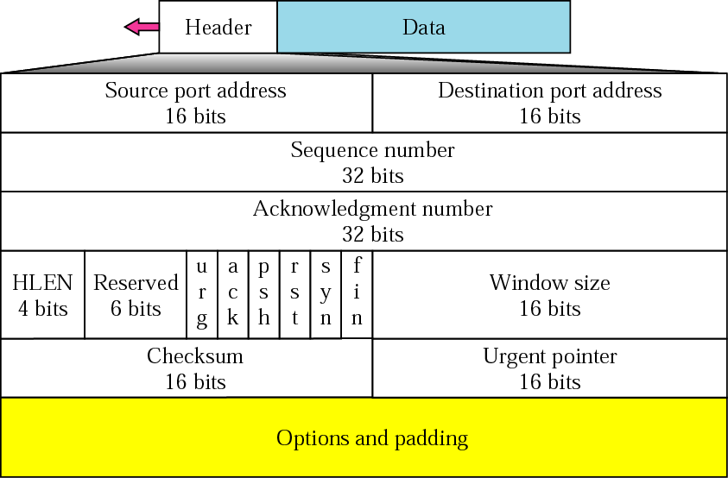
TCP segment format

Slide 32
The TCP Segment Header
Source Port, Destination Port : Identify local end points of the connections
Sequence number: Specifies the sequence number of the segment
Acknowledgement Number: Specifies the next byte expected.
TCP header length: Tells how many 32-bit words are contained in TCP header
Next comes a 6-bit field that is not used.
Now come six 1-bit flags

Slide 33
The TCP Segment Header
URG: It is set to 1 if URGENT pointer is in use, which indicates start of urgent data.
ACK: It is set to 1 to indicate that the acknowledgement number is valid.
PSH: Indicates pushed data
RST: It is used to reset a connection that has become confused due to reject an invalid segment or refuse an attempt to open a connection.
FIN: Used to release a connection.
SYN: Used to establish connections.

Slide 34
The TCP Segment Header
Window size - This field defines the window size of the sending TCP in bytes. Note that the length of this field is 16 bits
Checksum - This 16-bit field contains the checksum. The calculation of the checksum for TCP follows the same procedure as the one described for UDP.
Urgent pointer - This 16-bit field, which is valid only if the urgent flag is set, is used when the segment contains urgent data.
Options field -provides a way to add extra facilities not covered by the regular header.
most important option is the one that allows each host to specify the maximum TCP payload it is willing to accept

Slide 35
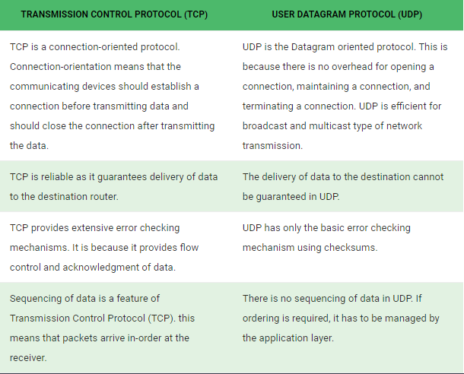

Slide 36
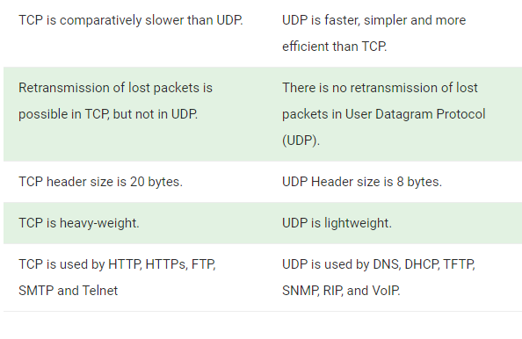

Slide 37
TCP CONNECTIONS
In TCP, connection-oriented transmission requires three phases:
Connection establishment
Data transfer
Connection termination.

Slide 38
TCP Connection Establishment
TCP transmits data in full-duplex mode.
When two TCPs in two machines are connected,they are able to send segments to each other simultaneously.
This implies that each party must initialize communication and get approval from the other party before any data are transferred.
The connection establishment in TCP is called threeway handshaking ,since it requires 3 steps to complete the connection establishment process

Slide 39
Connection establishment using three-way handshaking
Step 1:
The client sends the first segment, a SYN segment, in which only the SYN flag is set.
This special segment contains no application-layer data.
It does, however, have one of the flag bits in the segment's header the so-called SYN bit, set to 1.
For this reason, this special segment is referred to as a SYN segment.
Step 2:
The server sends the second segment, a SYN +ACK segment, with 2 flag bits set:SYN and ACK.
This segment has a dual purpose. It is a SYN segment for communication in the other direction and serves as the acknowledgment for the SYN segment.
Step 3:
The client sends the third segment. This is just an ACK segment.
It acknowledges the receipt of the second segment with the ACK flag and acknowledgment number field.

Slide 40
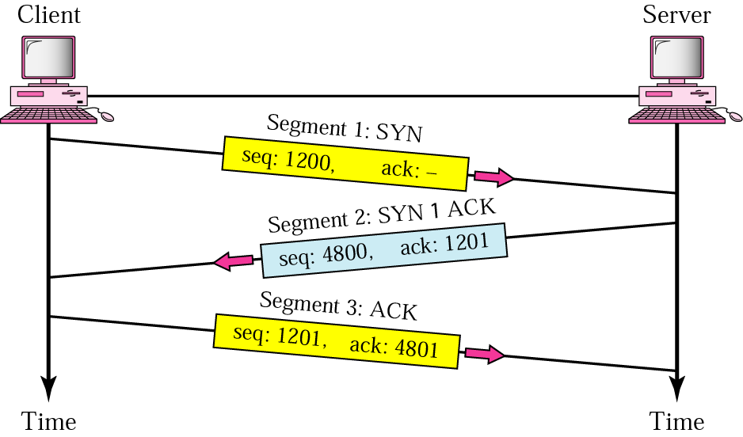
The Connection establishment using three-way handshaking

Slide 41
TCP Connection Release
To release a connection, either party can send a TCP segment with the FIN bit set, which means that it has no more data to transmit.
When the FIN is acknowledged, that direction is shut down for new data. Data may continue to flow indefinitely in the other direction, however.
When both directions have been shut down, the connection is released.
Normally, four TCP segments are needed to release a connection, one FIN and one ACK for each direction.
However, it is possible for the first ACK and the second FIN to be contained in the same segment, reducing the total count to three.

Slide 42
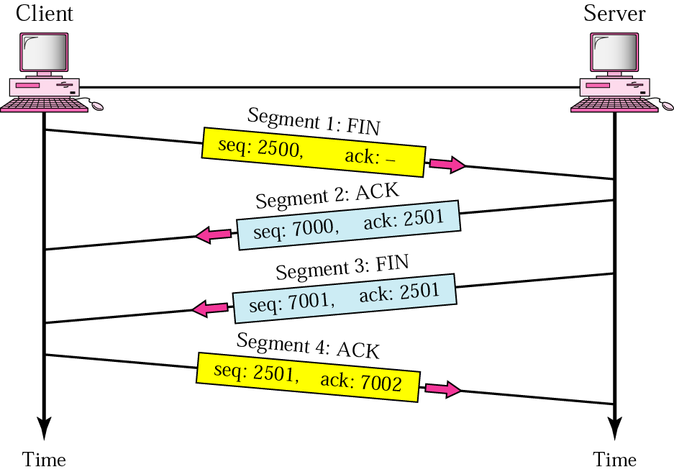
TCP Four-step connection termination

Slide 43
TCP Transmission Policy
TCP Transmission Policy is not directly tied to acknowledgements as it is in most data link protocols
Acknowledgement doesn’t allow the sender to transmit more
TCP uses the concept of window size for managing transmission of data.
Window field explicitly tells the sender how much it can transmit .
Basically, the window size indicates the size of the receive buffer

Slide 44
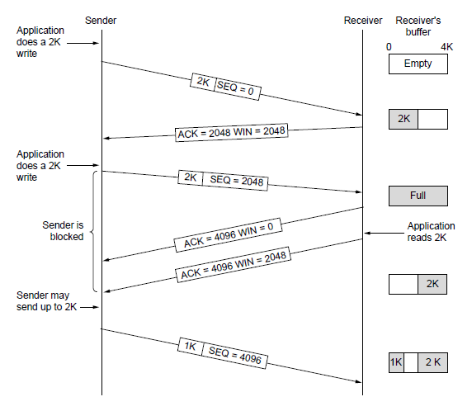
TCP Transmission Policy

Slide 45
TCP Transmission Policy
1. In the above example, the receiver has 4096-byte buffer.
2. If the sender transmits a 2048-byte segment that is correctly received, the receiver will acknowledge the segment.
3. Now the receiver will advertise a window of 2048 as it has only 2048 of buffer space, now.
4. Now the sender transmits another 2048 bytes which are acknowledged, but the advertised window is’0’.
5. The sender must stop until the application process on the receiving host has removed some data from the buffer, at which time TCP can advertise a layer window.

Slide 46
Silly Window Syndrome
Silly Window Syndrome is a problem that arises due to the poor implementation of TCP.
It degrades the TCP performance and makes the data transmission extremely inefficient.
The problem is called so because-
It causes the sender window size to shrink to a silly value.
The window size shrinks to such an extent where the data being transmitted is smaller than TCP Header

Slide 47
Causes of Silly Window Syndrome
The syndrome may arise because of the following problems −
Sender windows transmit one byte of data repeatedly.
Receiver windows accept one byte of data repeatedly.

Slide 48
Sender windows transmit one byte of data repeatedly
If an application which will generate only one byte of data. The TCP will transmit this small segment of data.
All time the application generates a single byte of data and the window transmits it.
This is because the transmission process becomes slow and inefficient. Here the sender window transmits one byte of data repeatedly.

Slide 49
Receiver window accepting one byte of data repeatedly
Suppose the receiver is not able to process all the incoming data.
In such a case, the receiver advertises a small window size.
The process repeats and the window size becomes too small.
Thus, the receiver repeatedly advertises window size of one byte.
Finally, the receiving process becomes slow and inefficient.

Slide 50
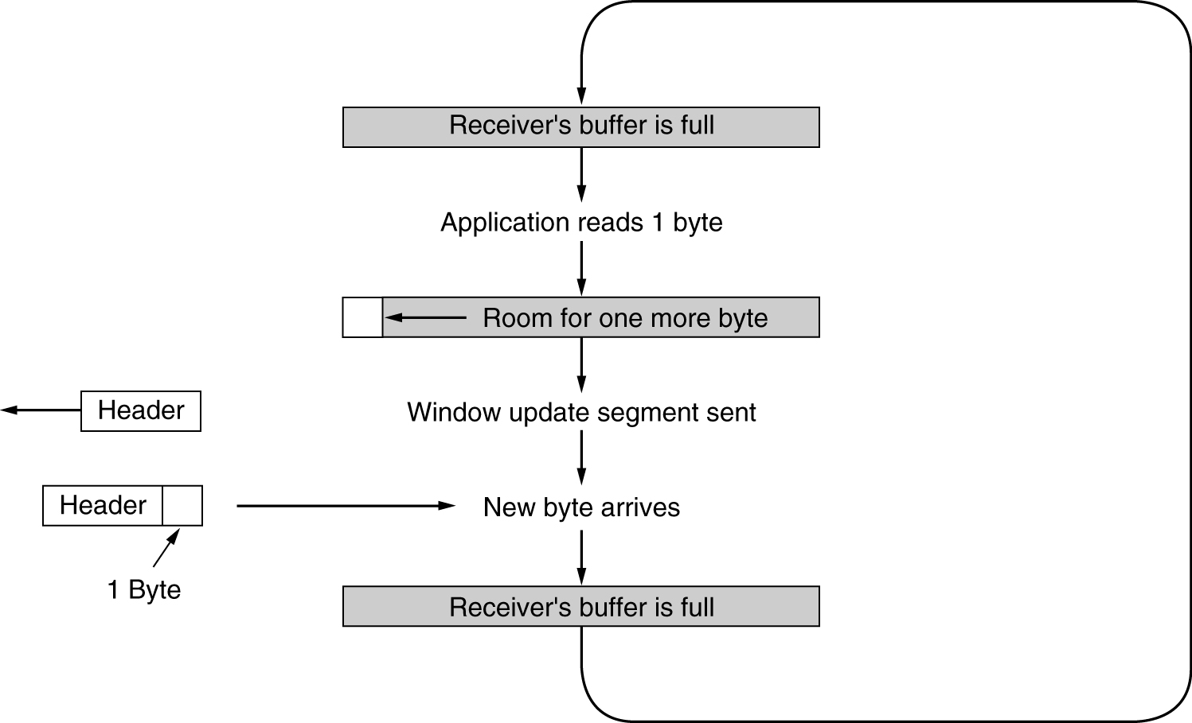
Silly Window Syndrome- Receiver window accepting one byte of data repeatedly
.

Slide 51
Silly Window Syndrome- Receiver window accepting one byte of data repeatedly
Initially the TCP buffer on the receiving side is full and the sender knows this(win=0)
Then the interactive application reads 1 character from tcp stream.
Now, the receiving TCP sends a window update to the sender saying that it is all right to send 1 byte.
The sender obligates and sends 1 byte.
The buffer is now full, and so the receiver acknowledges the 1 byte segment but sets window to zero.
This behavior can go on forever.

Slide 52
Silly Window Syndrome Solutions
Nagle's algorithm and Clark's solution
Nagle’s Algorithm tries to solve the problem caused by the sender delivering 1 data byte at a time.
Clark’s Solution tries to solve the problem caused by the receiver sucking up one data byte at a time.

Slide 53
Nagle's algorithm
Nagle’s algorithm suggests-
Sender should send only the first byte on receiving one byte data from the application.
Sender should buffer all the rest bytes until the outstanding byte gets acknowledged.
In other words, sender should wait for 1 RTT.
After receiving the acknowledgement, sender should send the buffered data in one TCP segment.
Then, sender should buffer the data again until the previously sent data gets acknowledged.

Slide 54
Clark’s solution
Clark’s solution suggests-
Receiver should not send a window update for 1 byte.
Receiver should wait until it has a decent amount of space available.
Receiver should then advertise that window size to the sender.

Slide 55
TCP congestion control.
Congestion control refers to techniques and mechanisms that can-
Either prevent congestion before it happens
Or remove congestion after it has happened

Slide 56
TCP congestion control.
TCP uses a congestion window(cwnd) in the sender side to do congestion avoidance
The congestion window indicates the maximum amount of data that can be sent out on a connection with out being acknowledged.
TCP detects congestion when it fails to receive an acknowledgement with in the estimated time out.
In such situation it decreases the congestion window to one maximum segment size.

Slide 57
Congestion Control in TCP
Congestion in TCP is handled by using these three phases:
Slow Start
Congestion Avoidance(Additive Increase )
Congestion Detection(Multiplicative Decrease)
Phase 2 & 3 combinely known as AIMD technique Additive Increase Multiplicative Decrease

Slide 58
Slow Start Phase : exponential increment
In Slow-start phase, TCP increases the congestion window each time an acknowledgement is received, by number of packets acknowledged.
This strategy effectively doubles the TCP congestion window for every round trip time (RTT)
In this phase after every RTT the congestion window size increments exponentially.
This phase continues until the congestion window size reaches the slow start threshold.
Slow start Threshold (ssthresh) is the Maximum number of TCP segments that receiver window can accommodate / 2

Slide 59
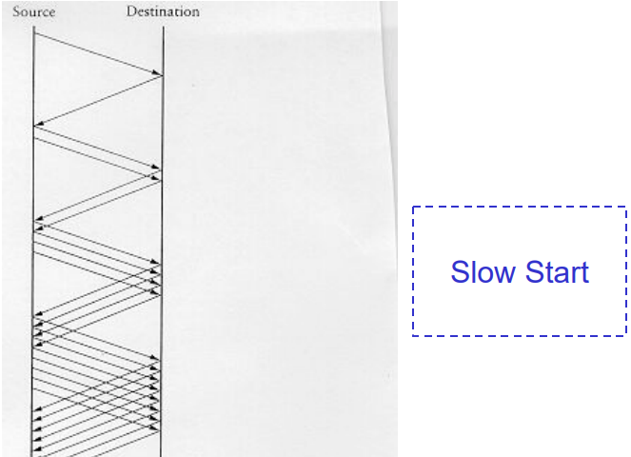
Slow Start Phase : exponential increment

Slide 60
Congestion Avoidance
After cwnd exceeds the ssthresh size, the TCP Congestion control mechanism enters the congestion avoidance phase
In this phase Sender increases the congestion window size linearly to avoid the congestion.
On receiving each acknowledgement, sender increments the congestion window size by 1 and the technique is known as Additive increase.
This phase continues until the congestion window size becomes equal to the receiver window size.

Slide 61
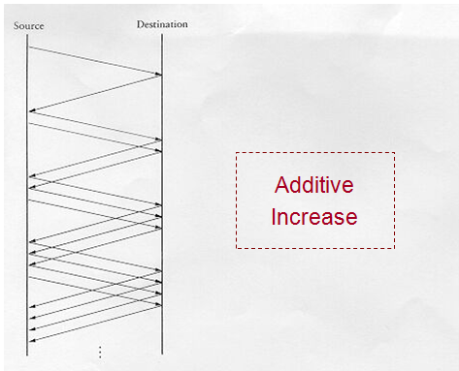
Packets in transit during additive increase

Slide 62
Congestion Detection Phase
In this phase, the sender identifies the segment loss
When sender detects the loss of segments, it reacts in different ways depending on how the loss is detected
Case-01: Detection On Time Out
In this, the timer time-out expires even before receiving acknowledgment for a segment.
In this case sender sets the slow start threshold to half of the current congestion window size.
Each time a timeout occurs, the source sets CongestionWindow to half of its previous value.
This halving of the CongestionWindow for each timeout corresponds to the “multiplicative decrease” part of AIMD(Additive Increase /Multiplicative Decrease)
Slow start phase is resumed

Slide 63
Congestion Detection Phase
Case-02: Detection On Receiving 3 Duplicate Acknowledgements-
If three ACKs are received, there is a weaker possibility of congestion; a segment may have been dropped, but some segments after that may have arrived safely since three ACKs are received.
This is called fast transmission and fast recovery.
Sender receives 3 duplicate acknowledgements for a segment.
This case suggests the weaker possibility of congestion in the network.
There are chances that a segment has been dropped but few segments sent later may have reached.
In this case, sender reacts by-
Setting the slow start threshold to half of the current congestion window size.
Decreasing the congestion window size to slow start threshold.
Resuming the congestion avoidance phase.

Slide 64
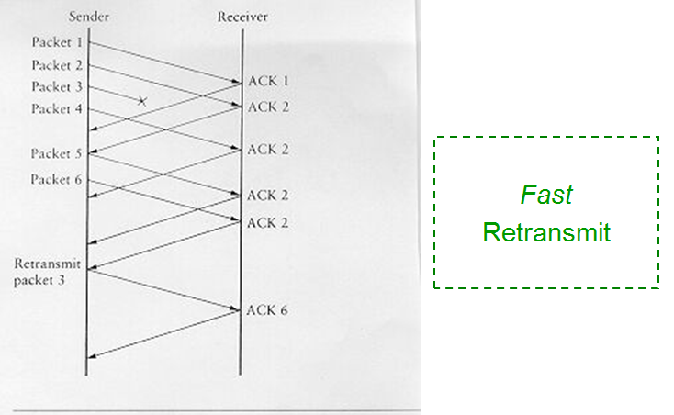

Slide 65
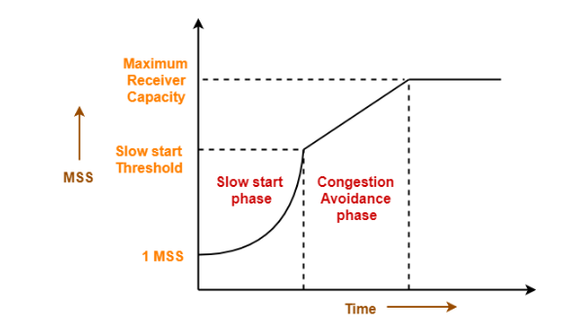

Slide 66
TCP Connection Management Modeling
The steps required to establish and release connections can be represented in a finite state machine with the 11 states
In each state, certain events are legal.
When a legal event happens, some action may be taken.
If some other event happens, an error is reported.

Slide 67
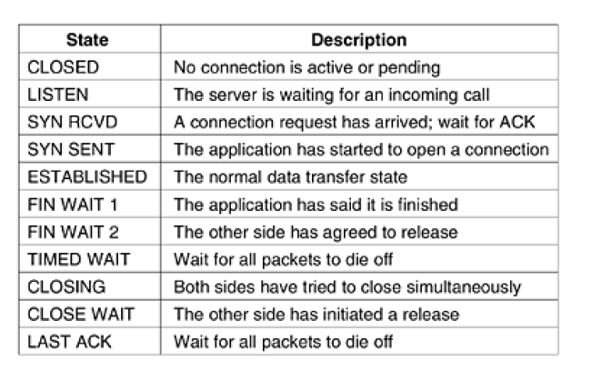
The states used in the TCP connection management finite state machine

Slide 68
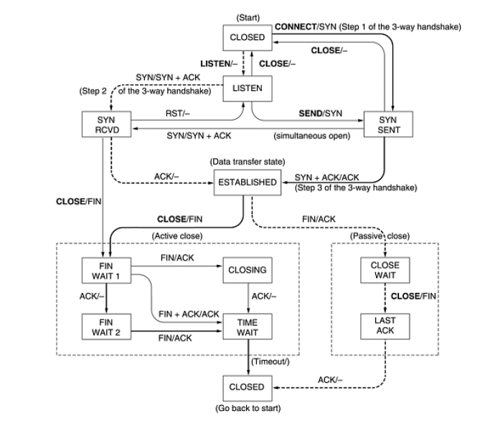
TCP connection management finite state machine

